Slide 1
Verification Modulo Versions Towards usable verification
F. Logozzo, S. Lahiri, Microsoft Research, Redmond
M. Fahndrich, now at Google
S. Blackshear, Univ. Colorado, Boulder

Slide 2
Background

Slide 3
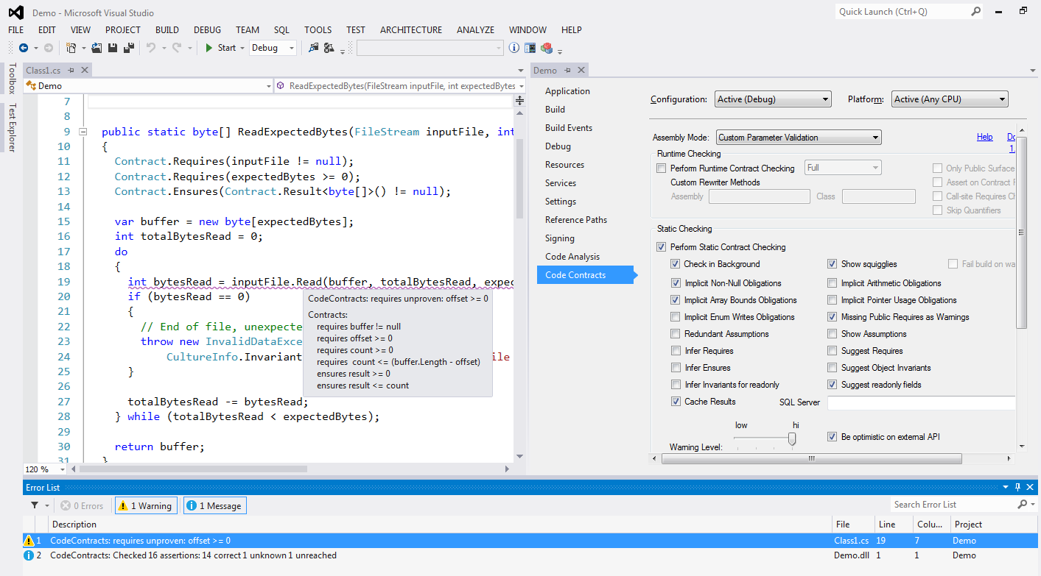
CodeContracts in VS
Compile-time verification
100% Abstract interpretation
Used internally at MSFT
> 120K external downloads
Failed precondition

Slide 4
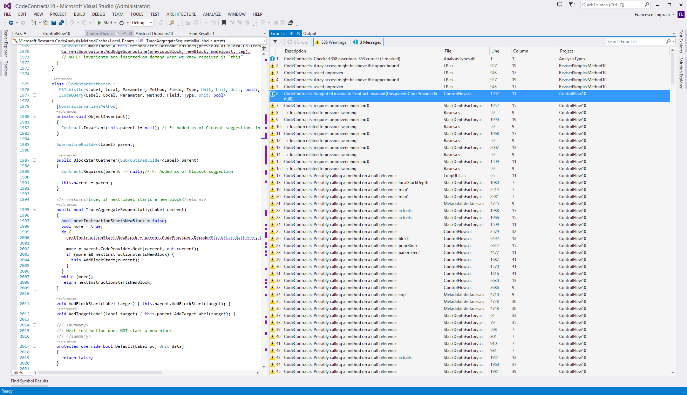
Too many warnings

Slide 5
Too many warnings: Now what?
False myth: Analysis too imprecise, let’s improve the analysis
In practice, the analysis is precise enough
Problem: It lacks information on external libraries, environment, physical world …
Academic solution: Address each warning
Add assumes, out-of-bands contracts …
Practice: No one is going to do it
Too expensive
Pragmatic: Syntactic baseline
Unsound and unreliable

Slide 6


Syntactic baseline
Base version
New version
(k Renamed)
/// Get temperature in Kelvin
double GetCurrTemperature()
{
// In Celsius
1: var c = ReadTemperature();
2: var k = c + 273.15;
3: Contract.Assert(k >= 0);
4: return k;
}
/// Get temperature in Kelvin
double GetCurrTemperature()
{
// In Celsius
1: var c = ReadTemperature();
2: var kelv = c + 273.15;
3: Contract.Assert(kelv >= 0);
4: return kelv;
}
“mask assertion at line 3”
Can’t prove assertion
Masked:
No alarm

Slide 7
Syntactic baseline: Fail to spot regression
Base version
New version
(wrong constant)
/// Get temperature in Kelvin
double GetCurrTemperature()
{
// In Celsius
1: var c = ReadTemperature();
2: var k = c + 273.15;
3: Contract.Assert(k >= 0);
4: return k;
}
/// Get temperature in Kelvin
double GetCurrTemperature()
{
// In Celsius
1: var c = ReadTemperature();
2: var k = c + 273.0;
3: Contract.Assert(k >= 0);
4: return k;
}
“mask assertion at line 3”
Masked regression!

Slide 8
Syntactic baseline: Resurrect alarm
Base version
New version
(value rounded)
/// Get temperature in Kelvin
double GetCurrTemperature()
{
// In Celsius
1: var c = ReadTemperature();
2: var k = c + 273.15;
3: Contract.Assert(k >= 0);
4: return k;
}
/// Get temperature in Kelvin
double GetCurrTemperature()
{
// In Celsius
1: var c = ReadTemperature();
2: var k = c + 273.15;
3: var round = Math.Round(k, 2);
4: Contract.Assert(round >= 0);
5: return round;
}
“mask assertion at line 3”
Alarm Resurrected

Slide 9
Verification Modulo Versions
Intuition

Slide 10
VMV: Verification modulo versions
P
Base version
P’
New version
Instrument
P’+C
Instrumented
Analyze
Analyze
Reduce alarms by > 80%
With semantic guarantees!!!
Extract semantic conditions C

Slide 11
VMV(S): Finding regressions
Base version
Instrumented
new version
/// Get temperature in Kelvin
double GetCurrTemperature()
{
// In Celsius
1: var c = ReadTemperature();
2: var k = c + 273.15;
3: Contract.Assert(k >= 0);
4: return k;
}
/// Get temperature in Kelvin
double GetCurrTemperature()
{
// In Celsius
1: var c = ReadTemperature();
Contract.Assume(c >= -273.15);
2: var k = c + 273.0;
3: Contract.Assert(k >= 0);
4: return k;
}
c ≥ -273.15
Correct
⇔
c ≥ -273.15
Report regression!

Slide 12
VMV(N): Relative proofs
Base version
Instrumented
new version
/// Get temperature in Kelvin
double GetCurrTemperature()
{
// In Celsius
1: var c = ReadTemperature();
2: var k = c + 273.15;
3: Contract.Assert(k >= 0);
4: return k;
}
/// Get temperature in Kelvin
double GetCurrTemperature()
{
// In Celsius
1: var c = ReadTemperature();
Contract.Assume(c >= -273.15);
2: var k = c + 273.15;
3: var round = Math.Round(k, 2);
4: Contract.Assert(round >= 0);
5: return round;
}
c ≥ -273.15
Correct
⇔
c ≥ -273.15
Relative correctness

Slide 13
Questions
2. How do we inject them?
P
Base version
P’
New version
Instrument
P’+C
Instrumented
Analyze
Analyze
Extract semantic conditions C
3. Which guarantees?
1. Which conditions?

Slide 14
Verification Modulo Versions
Formalization

Slide 15
Q1. Which conditions?
Critical to distinguish between sufficient and necessary conditions
A sufficient condition S implies the program correctness
S ⟹ “program has no bad runs”
S can be under-approximated
At worst false
A correct program implies a necessary condition N
If R is a good program run, then R ⟹ N
N can be over-approximated
At worst true

Slide 16
Example: Sufficient vs. Necessary
public void Foo()
{
int ret, x;
if(*)
{
ret = API();
x = ret + 1;
}
else
{
ret = API();
x = ret - 1;
}
Contract.Assert(x > 100);
}
Property of good runs
Strongest Necessary for API
ret > 99 ∨ ret >101
= ret > 99
ret > 99
Removes all bad runs
Weakest Sufficient for API
ret > 99 ∧ ret >101
= ret > 101
ret > 101

Slide 17
Q2: Matching and injection
public void Foo()
{
int ret, x;
if(*)
{
ret = API();
x = ret + 1;
}
else
{
ret = API();
x = ret - 1;
}
Contract.Assert(x > 100);
}
Match method calls
public void Foo()
{
int x;
x = API();
Contract.Assert(…);
}
Other matching solutions:
Sequences of method calls, program point …
See paper
In general
More refined matching ⟹ more precision
More refine matching ⟹ more brittle

Slide 18
Q3: Semantic guarantees for P’?
Using sufficient conditions
Short VMV(S)
Theorem: All warnings in P’+ S are new alarms
S was sufficient to shut off all alarms in P
Each new alarm in P’+S is either
1. in new code or
2. S is not strong enough
Nothing can be said on the “verified” assertions
E.g., S can be too strong
VMV(S) useful for bug finding

Slide 19
Example of VMV(S)
public void Foo()
{
int ret, x;
if(*)
{
ret = API();
x = ret + 1;
}
else
{
ret = API();
x = ret - 1;
}
Contract.Assert(x > 100);
}
public void Foo()
{
int x;
x = SomeAPI();
Contract.Assume(x > 101);
Contract.Assert(x > 105);
}
Regression:
Ask more to API

Slide 20
Q3: Semantic guarantees for P’?
Using necessary conditions
Short VMV(N)
Theorem: All proven assertions in P’+ N are correct w.r.t. P
N holds in all good runs of P
Each proven assertion in P’+ N is either
1. because of an assume from N, or
2. Absolute, i.e., without assumptions from P
Nothing can be said on alarms
E.g. N can be too weak
VMV(N) is useful for relative verification

Slide 21
Example of VMV(N)
public void Foo()
{
int ret, x;
if(*)
{
ret = API();
x = ret + 1;
}
else
{
ret = API();
x = ret - 1;
}
Contract.Assert(x > 100);
}
public void Foo()
{
int x;
x = SomeAPI();
Contract.Assume(x > 99);
Contract.Assert(x > 0);
}
Relative verification:
Holds for good runs of P

Slide 22
Experiments

Slide 23
Experimental setting
Implemented VMV(N) in Clousot/cccheck
Developed for 7+ years at Microsoft Research
Used by .NET programmers, free download, VS integration
Internal and external adoption
Abstract interpretation-based
Analyze program to infer invariants at each program point
Use invariants to discharge proof obligations
Contracts, null-pointers, division by zero, buffer overruns, arithmetic overflow, enums ….
Infer necessary conditions
Run on very large code bases
Internal and open source

Slide 24
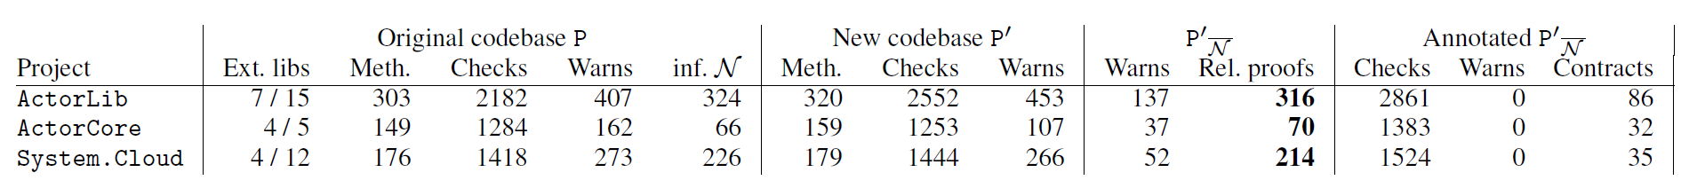
Windows Azure ActorFX framework
Three months among P and P’
VMV(N) dramatically reduces the number of alarms (roughly by 70%)
Still semantic guarantees!
Eliminated great majority of the warnings from external non-annotated API
We added annotations to P’+ N to go to 0 warnings
Less than 3 hours overall
Found bugs, reported to the developers

Slide 25
Conclusions

Slide 26
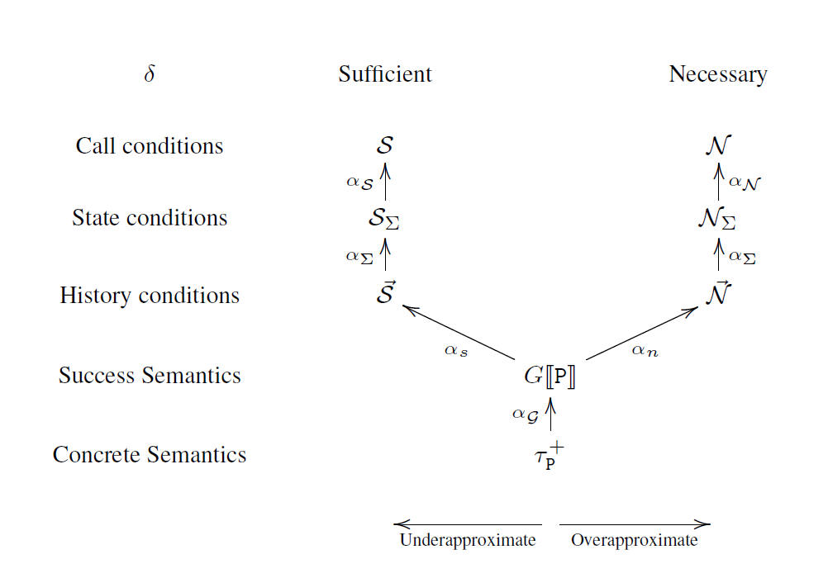
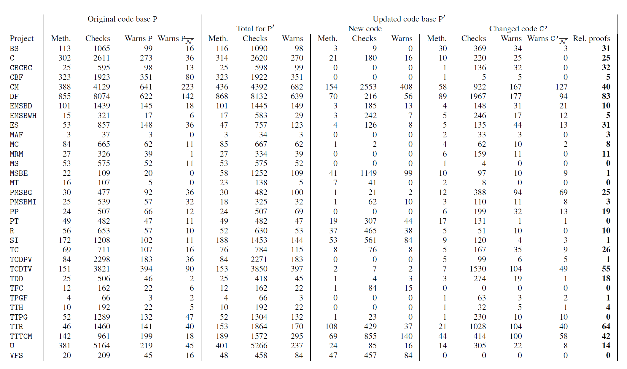
More in the paper
Greek letters
Numbers
Scenarios
Abstraction of necessary/sufficient
Role of imprecision in the analyzer
Abstract regressions in VMV(S)
Impact of non-monotonic analyzers
i.e., all too out there…
Self application
Analyze P+N
…

Slide 27
Conclusions
Match method calls
P
Base version
P’
New version
Instrument
P’+C
Instrumented
Analyze
Sufficient
⟹ bug finding
Analyze
Extract semantic conditions C
Necessary
⟹ relative verification
Sufficient or Necessary

